Slide 1
Game Day Overview

Slide 2
Run of Show
Prep
Tailgate
First Half
Halftime
Second Half
Notes:
Sarah will make a recommendation to the BOD

Slide 3
Play by Play
Prep | Playbook
Tailgate | Goal Playbook Practice
First Half | Goal Playbook Practice
Half Time | Goal Playbook Practice
Second Half | Goal Playbook Practice

Slide 4
Tailgate: GOAL
Make people feel welcome, comfortable and prepared to have fun

Slide 5
Tailgate: PLAYBOOK
Host welcomes guests
Host introduces emcee(s)
Emcee thanks host(s) and welcomes guests
Emcee shows Ravens/Thread video (cd, USB, Youtube)
Emcee explains the Run of Show for the day
a. Trivia & conversation during commericals
b. Raffles for Ravens/Thread swag
c. Learning about the Thread movement
6. Emcee facilitates ice-breaker with trios finding 3 things
in common and one unique to each individual

Slide 6
Tailgate: PRACTICE

Slide 7
Host Welcome: Part I
Thank you so much for coming today;
We are so happy to have you join us for Gameday Conversations, a unique and exciting new partnership between the Ravens and Thread;
If I had to guess, there’s probably nothing like this in any other city;
Obviously everyone here is familiar with the Ravens, but many of you may not have heard of Thread before today;
Thread is a community building organization that creates opportunities for people from all walks of life to create strong relationships with one another;

Slide 8
Host Welcome: Part II
Thread believes that empathetic and enduring relationships are our societies most essential form of wealth. Over the last 15 years they’ve been cultivating relationships that cross lines of race, class, and zip code to establish a wealth of human connections that are moving Baltimore toward a more equitable future.
These two organizations may seem like unlikely collaborators, but together they realized that watching the game is a great space to bring people together for more than just cheering.
As an aside, I want everyone to know that since this partnership was conceived a few weeks ago, the Ravens have been winning, so hopefully we will keep this streak going today.

Slide 9
Host Welcome: Part III
Today is an opportunity to have fun and connect through conversation about the game, our city, and ourselves.
I think as we start to get to know one another, we’ll find that we have a significant number of shared interests, ideas, and values.
And while we might express ourselves in different ways, I hope everyone will see this as a comfortable space for people to talk about differences and find common ground.
So I want to introduce you to _____________. He/she/they will be our for the day.
If you haven’t already, please sign-in, grab a nametag and a raffle ticket. (If you are familiar with guests & able to share attendance list, okay to skip.)

Slide 10
Emcee Welcome: Part I
Hi. I’m __________________. I’m excited to be here with all of you. We’re going to have a lot of fun today sharing good food, fun people, and real conversation, as we cheer on our home team—the Ravens!
During commercial breaks we’re going to challenge you with Ravens, Baltimore, and Thread trivia that’s going to lead to some conversations about the community that we all share.
We’ll also raffle off some great prizes so hold onto your raffle tickets.

Slide 11
Emcee Welcome: Part II
During half-time, we’ll let everyone grab another bite or drink, then [host] is going to take a few minutes to share a little bit about the movement that Thread is building in Baltimore and how you can get involved in creating a more connected and equitable city.
But don’t worry. This is not a fundraiser. It’s a friendraiser. So have fun, meet some new people, and enjoy a great game!

Slide 12
First Half: GOAL
Open up conversation, get people thinking

Slide 13
First Half: PLAYBOOK
Divide groups of 10-20 guests into 2 teams, each with one emcee and one trivia deck
Encourage everyone to play one card during each commercial
As the clock winds down to half time, prepare everyone that the host will share more about the Thread movement at half time

Slide 14
First Half: PRACTICE

Slide 15
Things to Remember: Part I
Communicate that you have room for growth
You may refer to this as “showing humility”;
Tell people that you are not the expert, so you may make mistakes - we all do;
Own it publically if someone says you made them feel a certain way

Slide 16
Things to Remember: Part II
Assume that people have the best intentions
Assure people that you hear and see them - repeat and paraphrase to show this;
Affirm that you accept their perceptions & experiences as truth;
Remind participants of this phrase (“assume best intentions”) to guide discussion

Slide 17
Things to Remember: Part III
Make the table accessible
Model Active Listening - create safe space, notice body; language, hold your thoughts, repeat & paraphrase, and ask more questions than offering answers
Invite silent voices to share (ex. count to 5 slowly before calling on someone);
Ask others’ to share when thought-provoking questions emerge in discussion

Slide 18
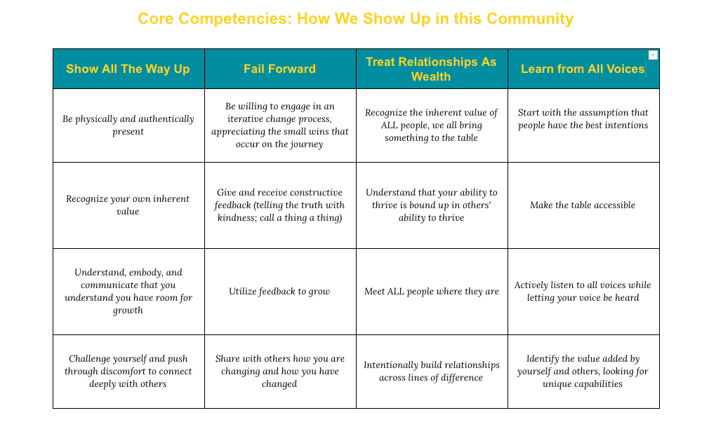

Slide 20
Half Time: GOAL
Invite guests to join the Thread movement by participating as a volunteer, collaborator and/or champion

Slide 21
Half time: PLAYBOOK
Emcee gathers everyone back together
Emcee “kicks” it over to the host
Host presents opportunity to participate in Thread

Slide 22
Half time: PRACTICE

Slide 23
Host Invitation to Thread: Part I
Before we get to ____ [fill in what’s coming next - grabbing more food, giving away prizes/swag/raffles, heading home], I would love to share a little more about Thread with those of you who aren’t as familiar with their work. [Fill in with your connection to Thread - how long & in what capacity]
Thread is a community of young people, alumni, volunteers, collaborators, staff & Board - dedicated to tackling social isolation by building relationships that cross lines of race, income, age, religion - any difference that typically keeps us apart.
Thread’s track record of success has proven that those relationships can change lives in extraordinary & meaningful ways.

Slide 24
Host Invitation to Thread: Part II
Thread enrolls 9th grade students facing some of the toughest odds to success - academically in the bottom 25% & facing enormous challenges outside of the classroom.
Their young people remain in Thread for 10 years, no matter what.
Thread connects students with a group of up to four volunteers, and they become an extended family for one another - getting to know one another, facing challenges together, celebrating & growing together.
Thread students outperform their peers by 10 to 1. 6% of BCPSS freshman with GPAs <1.0 graduate in 4 years. In Thread, 65% graduate in 4 years and 85% in 6 years.

Slide 25
Host Invitation to Thread: Part III
Thread has an ambitious vision for growth – this winter they will enroll 2.5% of freshman across Baltimore City and eventually grow to enrolling 7% (300 students).
At full scale, Thread will be a community of nearly 20,000 adults in Baltimore - students, families, alumni, volunteers, collaborators, staff, & Board. This group represents 5% of Baltimore’s adult population & seeds for a movement that can truly change the whole city.
I would like to personally invite you to join Thread’s growing community, to find a role that’s the right fit for you – whether that be volunteering with a young person or coaching other volunteers or supporting as a collaborator or champion.

Slide 26
Host Invitation to Thread: Part IV
There are materials here for you to look at and people who are already part of Thread who are happy to share their experience [ask guests affiliated with Thread to raise their hands]
You will receive a follow-up email tomorrow with details on how to learn more, and I encourage you to take advantage of the opportunities to do so!
There is an information session this Wednesday December 12 at R. House and we have a sign-up sheet here is you are interested in getting engaged.

Slide 27
Second half: GOAL
Relax. Hang out. Tend to the needs of your guests.

Slide 28
Second half: PLAYBOOK
Temperature check the room
Respond to the room
a. Continue to play trivia;
b. Watch the game; or
c. Delve deeper into conversation.

Slide 29
Second half: PRACTICE

Slide 30
#GAMEDAYCONVERSATIONS
&
Take a picture of your group!

Slide 31
Huge THANKS !!!!
If you have additional questions, please fill out the doodle for a Friday or Saturday call with Sarah or Marie

